Slide 1
PRODUCTION INEFFICIENCY
CONESTOGA DESIGN LTD.
INFO8440 || April 23rd, 2020 || Project 3
Brijesh Patel, Hyojin Ahn, Sanket Batra, Divjot Kaur, Bhupinder Singh
BY GROUP 1

Slide 2

Outline
Our Approach for the Project
History Of CDL
CDL Team
CDL at Present – As Is
CDL in Future – To Be
Floor Plan and Component Picking
Assembly Process
Staffing Suggestion
Profit and Loss projection
Assumptions

Slide 3
Our Approach for the Project
Gathered
Requirements
Understood and analyzed current state of CDL
Researched and compared different solutions
Discussed and documented the solution

Slide 4
History Of CDL
Jan. 1998
CDL Begins Business
Jan. 2014
Became market Leader
Feb. 2015
TrackR Launch Event
Mar. 2016
Highest Sales
July 2016
7000 TrackR product returned to CDL
Dec. 2016
Meeting: Bankruptcy News!!!
Feb. 2017
Executive Dashboard in operation
Mar. 2017
Discovered need of a Modern Website
Current Day
Found Production Flaws

Slide 5
CDL Team
Billy Bob CEO
Manufacturing VP
Human Resource VP
Finance VP
Facilities VP
Marketing VP
Information Technology VP

Slide 6
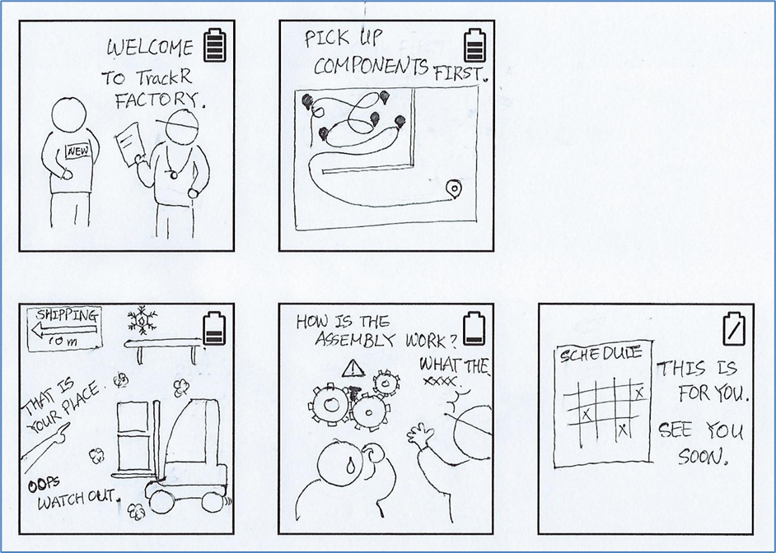
CDL at Present As Is
CDL uses dashboard on daily basis.
CDL uses website to expand their business.
CDL is manufacturing TrackR according to demand.
CDL is meeting demand and supply.
Still CDL cannot generate profit for manufactured products.
CDL experiencing production inefficiency.

Slide 7


Computer
During 1 Shift
3 Maintenance worker
Total 12 workers per shift
Table
A
COMPONENT
SHELVES
Table
B
3 Standby
3 Assemblers
3 Pickers
Table
C

Slide 8
CDL in Future To Be
Change in warehouse floorplan.
Change in picking and assembly process.
Automation in place.
Six Sigma techniques.
Efficiently scheduling staff
Increased Daily Profit.

Slide 9
Solution!!!
Explained in 5 different Parts by
Different Team Members
Sanket Batra → Floorplan and Component Picking
Brijesh Patel → Assembly Suggestions. Sunny and Rainy Day
Hyojin Ahn → Staffing Suggestion and Profit Loss Explanation
Bhupinder Singh → Six Sigma Implementation
Divjot Kaur → Automation Implementation

Slide 10
Sanket Batra
Floor-plan and Component Picking

Slide 11
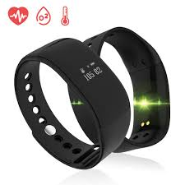
Components and there locations
Manufacturer | Part Number | Row | Bay
BlueGiga | BLE112 | 1 | B
American Vanadium | SFLV25 | 2 | A
SanDisk | SDMALBB3033G | 3 | C
Foxconn | FnOFI-GN1212 | 4 | D
Qualcomm | BD2098733AAB | 5 | E
Qualcomm | BD20911131BB | 6 | B
Samsung | SS98AAIS | 7 | E
ST Microelectronics | HG213123-221 | 7 | B
Mitchell’s Plastics | MPC44422 | 10 | E
Mitchell’s Plastics | MPC432119-2 | 10 | C
Banda Bracelets (HK) Ltd. | LS1121 | 14 | A
ST Microelectronics | STMA11233 | 8 | E

Slide 12
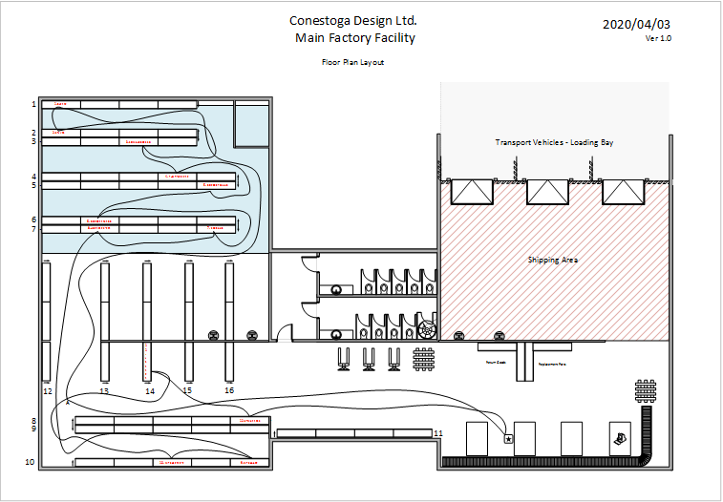
CDL Factory Layout As-Is

Slide 13


As-Is Roadmap
C – 4
8.13
C – 9
C – 12
2.85
C – 6
13.1
C – 7
5.01
C –11
6.68
A
37.18
C - 1
25.54
27.04
16.28
1.93
7.54
7.07
18.27
C – 2
15.23
C – 3
C – 8
C – 10
Champion
Champion
C – 5

Slide 14
As-Is Calculations
Starting Point | Ending point | Location | Distance (meters) | Minutes Min | Minutes Max | Minutes Avg | Pick Up Action | Total avg Time
Champion | Point A |  | 27.04 | 0.27 | 0.32 | 0.30 | 0.00 | 0.30
Point A | Component 1 | Shelf 1 - Bay A | 37.18 | 0.37 | 0.45 | 0.41 | 0.08 | 0.49
Component 1 | Component 2 | Shelf 2 - Bay A | 1.93 | 0.02 | 0.02 | 0.02 | 0.08 | 0.10
Component 2 | Component 3 | Shelf 3 - Bay C | 15.23 | 0.15 | 0.18 | 0.17 | 0.08 | 0.25
Component 3 | Component 4 | Shelf 4 - Bay D | 2.85 | 0.03 | 0.03 | 0.03 | 0.08 | 0.11
Component 4 | Component 5 | Shelf 5 - Bay E | 8.13 | 0.08 | 0.10 | 0.09 | 0.08 | 0.17
Component 5 | Component 6 | Shelf 6 - Bay B | 7.07 | 0.07 | 0.08 | 0.08 | 0.08 | 0.16
Component 6 | Component 7 | Shelf 7 - Bay E | 13.1 | 0.13 | 0.16 | 0.14 | 0.08 | 0.23
Component 7 | Component 8 | Shelf 7 - Bay B | 7.54 | 0.08 | 0.09 | 0.08 | 0.08 | 0.17
Component 8 | Component 9 | Shelf 10 - Bay E | 25.54 | 0.26 | 0.31 | 0.28 | 0.08 | 0.36
Component 9 | Component 10 | Shelf 10 - Bay C | 5.01 | 0.05 | 0.06 | 0.06 | 0.08 | 0.14
Component 10 | Component 11 | Shelf 14 - Bay A | 18.27 | 0.18 | 0.22 | 0.20 | 0.08 | 0.28
Component 11 | Component 12 | Shelf 8 - Bay E | 6.68 | 0.07 | 0.08 | 0.07 | 0.08 | 0.16
Component 12 | Champion |  | 16.28 | 0.16 | 0.20 | 0.18 | 0.00 | 0.18
Total |  |  | 191.85 | 1.92 | 2.30 | 2.11 | 1.00 | 3.11
Total Distance Travelled
191.85 metres
Average time taken to pick and bring all the components
3.11 seconds

Slide 15
Pain points in current process
Solution?
Proposed solution is focused to:
Reduce total time to pick all the products.
Overall, cost cutting for the company.
Arrange components effectively.
We are suggesting two options:
To much distance to cover from champion towards picking the first component.
Assembling tables are too far from the components.
Components are not arranged effectively.

Slide 16
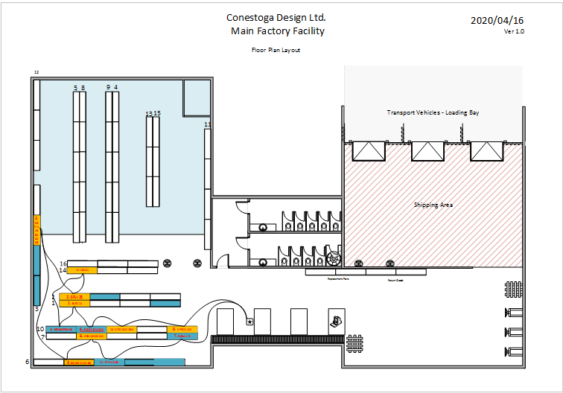
Proposed Solution
Option 1
In this, my suggestion would be to arrange components effectively.
Bring the assembly tables close to the shelves.
Note:
Blue box : Components whose location is not fixed.
Yellow Box : Components whose locations is fixed

Slide 17
To-Be Option 1 Roadmap
C – 5
5.52
C – 12
C - 1
C - 2
2.04
C – 7
5.73
C – 8
2.62
C –11
5.93
4.87
6.24
7.92
2.87
11.2
1.97
2.08
C – 3
2.18
C – 4
C – 9
C – 10
Champion
Champion
C – 6

Slide 18
To-Be Option 1 Calculations
Starting Point | Ending point | Location | Distance (meters) | Minutes Min | Minutes Max | Minutes Avg | Pick Up Action | Total avg Time
Champion | Component 9 | Shelf 10 - Bay E | 6.24 | 0.06 | 0.07 | 0.10 | 0.08 | 0.18
Component 9 | Component 10 | Shelf 10 - Bay C | 4.87 | 0.05 | 0.06 | 0.08 | 0.08 | 0.16
Component 10 | Component 4 | Shelf 10 - Bay B | 2.87 | 0.03 | 0.03 | 0.05 | 0.08 | 0.13
Component 4 | Component 1 | Shelf 1 - Bay A | 2.18 | 0.02 | 0.03 | 0.03 | 0.08 | 0.12
Component 1 | Component 5 | Shelf 10 - Bay A | 2.04 | 0.02 | 0.02 | 0.03 | 0.08 | 0.12
Component 5 | Component 11 | Shelf 14 - Bay A | 5.52 | 0.06 | 0.07 | 0.09 | 0.08 | 0.17
Component 11 | Component 2 | Shelf 2 - Bay A | 1.97 | 0.02 | 0.02 | 0.03 | 0.08 | 0.11
Component 2 | Component 3 | Shelf 3 - Bay C | 5.73 | 0.06 | 0.07 | 0.09 | 0.08 | 0.18
Component 3 | Component 6 | Shelf 6 - Bay B | 11.2 | 0.11 | 0.13 | 0.18 | 0.08 | 0.26
Component 6 | Component 8 | Shelf 7 - Bay B | 2.62 | 0.03 | 0.03 | 0.04 | 0.08 | 0.13
Component 8 | Component 12 | Shelf 6 - Bay C | 2.08 | 0.02 | 0.02 | 0.03 | 0.08 | 0.12
Component 12 | Component 7 | Shelf 7 - Bay E | 5.93 | 0.06 | 0.07 | 0.09 | 0.08 | 0.18
Component 7 | Champion |  | 7.92 | 0.08 | 0.10 | 0.13 | 0.00 | 0.13
Total |  |  | 61.17 | 0.61 | 0.73 | 0.98 | 1.00 | 1.98
Total distance travelled
61.17 metres
Total time taken
118.8 seconds

Slide 19
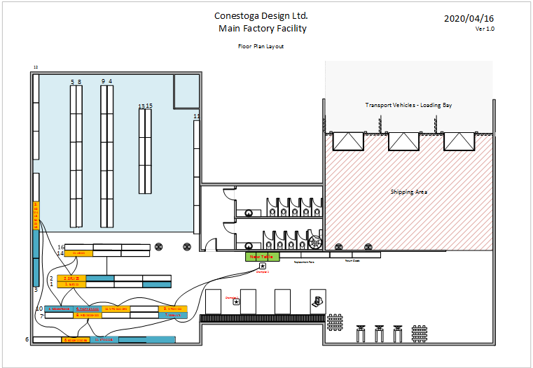
Proposed Solution
Option 2
To make process more efficient, I recommend to introduce one more table in the process.
Use : To place picked location.
Benefit : Picker will not have to wait till the other worker completes assembling.
Rest, all the component locations remain the same as option 1.

Slide 20
To-Be Option 2 Roadmap
C – 5
5.52
C – 12
C - 1
C - 2
2.04
C – 7
5.73
C – 8
2.62
C –11
5.93
4.87
7.80
9.19
2.87
11.2
1.97
2.08
C – 3
2.18
C – 4
C – 9
C – 10
Champion 2
Champion 2
C – 6

Slide 21
To-Be Option 2 Calculations
Starting Point | Ending point | Location | Distance (meters) | Minutes Min | Minutes Max | Minutes Avg | Pick Up Action | Total avg Time
Champion 2 | Component 9 | Shelf 10 - Bay E | 7.80 | 0.08 | 0.09 | 0.12 | 0.08 | 0.21
Component 9 | Component 10 | Shelf 10 - Bay C | 4.87 | 0.05 | 0.06 | 0.08 | 0.08 | 0.16
Component 10 | Component 4 | Shelf 10 - Bay B | 2.87 | 0.03 | 0.03 | 0.05 | 0.08 | 0.13
Component 4 | Component 1 | Shelf 1 - Bay A | 2.18 | 0.02 | 0.03 | 0.03 | 0.08 | 0.12
Component 1 | Component 5 | Shelf 10 - Bay A | 2.04 | 0.02 | 0.02 | 0.03 | 0.08 | 0.12
Component 5 | Component 11 | Shelf 14 - Bay A | 5.52 | 0.06 | 0.07 | 0.09 | 0.08 | 0.17
Component 11 | Component 2 | Shelf 2 - Bay A | 1.97 | 0.02 | 0.02 | 0.03 | 0.08 | 0.11
Component 2 | Component 3 | Shelf 3 - Bay C | 5.73 | 0.06 | 0.07 | 0.09 | 0.08 | 0.18
Component 3 | Component 6 | Shelf 6 - Bay B | 11.20 | 0.11 | 0.13 | 0.18 | 0.08 | 0.26
Component 6 | Component 8 | Shelf 7 - Bay B | 2.62 | 0.03 | 0.03 | 0.04 | 0.08 | 0.13
Component 8 | Component 12 | Shelf 6 - Bay C | 2.08 | 0.02 | 0.02 | 0.03 | 0.08 | 0.12
Component 12 | Component 7 | Shelf 7 - Bay E | 5.93 | 0.06 | 0.07 | 0.09 | 0.08 | 0.18
Component 7 | Champion 2 |  | 9.19 | 0.09 | 0.11 | 0.15 | 0.00 | 0.15
Total |  |  | 64.00 | 0.64 | 0.77 | 1.02 | 1.00 | 2.02
Total distance travelled
64 metres
Total time taken
121.2 seconds

Slide 22
Benefits of Option2 on Option1
Though, distance covered in option 2 to will be 2.83 metres more.
And, 2.4 seconds more in component picking process.
But, we have a window, to reduce man power in the assembling process.
Which can reduce costing of the entire process and make process efficient compared to current process.
We recommend CDL to go with
Option 2.

Slide 23
Brijesh Patel
Assembly Suggestions.
Sunny and Rainy Day

Slide 24
What is…
Sunny Day
Sunny Day for assembling process says that, during the assembly all the steps yields 100% success and there is 0% fail rate of any task and components being used.
Rainy Day
Rainy Day for assembly process says that, during the assembly any one of the steps does not yield 100% success. There can be 1 or more failure while assembling the component
It is always a dream for any manufacturer to achieve Sunny Day all day, which is somewhat difficult.

Slide 25
TIME FOR
EXCEL!!!

Slide 26
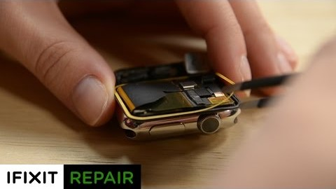
Video for Adhesive Sealing!!!

Slide 27
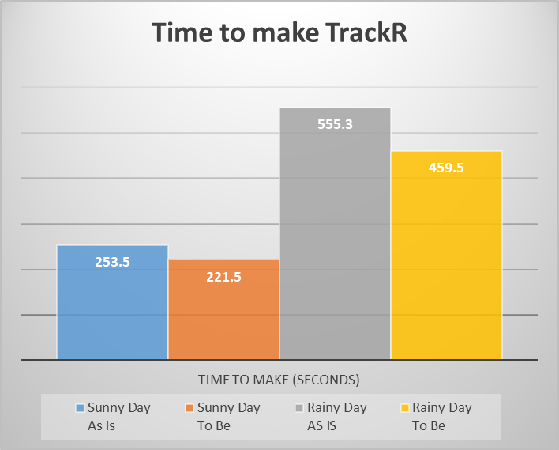
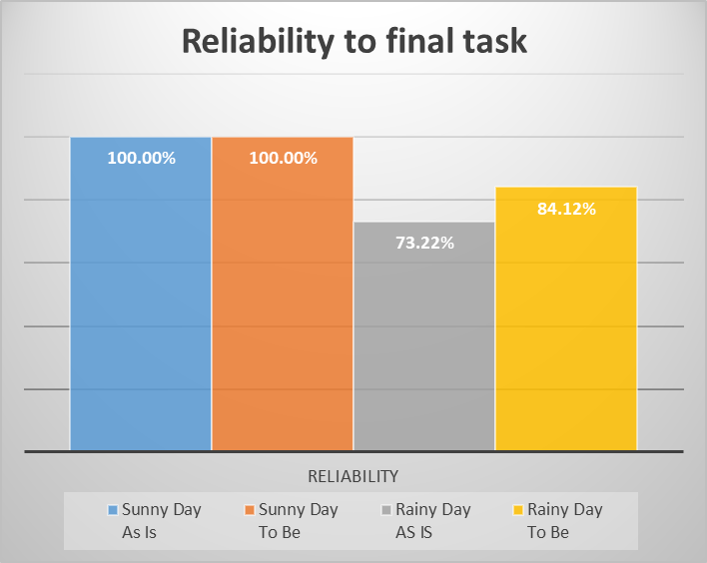
Final Comparision!!!
Checkpoints | Sunny Day As Is | Sunny Day To Be | Rainy Day AS IS | Rainy Day To Be
Time to make (seconds) | 253.5 | 221.5 | 555.3 | 459.5
Reliability | 100.00% | 100.00% | 73.22% | 84.12%

Slide 28
Hyojin Ahn
Staffing Suggestions
Profit and Loss Explanation

Slide 29

Survey
Worker’s attitudes toward change on Mar 24 (Conestoga College, 2020).
Code 3 is the target of the Staffing Solution.
Attitude Code | Code Description | Count
1 | No Change Needed | 2
2 | Minor Tweaks / New Equipment Needed | 7
3 | Training / Work Optimization Needed | 9
4 | Movement Changes Needed | 10
5 | Layout (and 4,3,2) Changes Needed | 5
6 | Total New facility needed | 3
Total |  | 36

Slide 30
Survey (Cont.)
Attitude Code by Shift
Attitude Code by Role
The respondents of Code 3 are concentrated in Team Lead and Team Member or Shift 1 and 2, which are in the TrackR Department.

Slide 31
Staffing AS-IS
There are 3 tables to make TrackRs.
They have 10 minutes break every 1 hour.
This schedule for 1 hour is repeated during a shift.

Slide 32
Staffing AS-IS (Cont.)
Pick
Assembly
Standby
Making TrackR’s phase:
Pick Assembly Standby
One picks components and come back to the table, someone else is doing the assembly.
Inefficiency has been found.

Slide 33
Waiting
One of the Seven Types of Muda.

Slide 34




Inefficiency - Waiting
Assembly
0.00 min
3.11 min
5.00 min
Pick Up
Waiting

Slide 35
Inefficiency - Waiting (Cont.)
This happens 10 times in an hour.
Pick
Assembly
…
Waiting
Waiting
Waiting
1.89 min
1.89 min
1.89 min
Working
Waiting
18.90 min

Slide 36
Time Wasted Waiting for 1 Day
Waste 18.90 min per hour
18.90 min
453.50 min
8 hours per shift
× 8
2 shifts per day
× 2
3 tables
× 3

Slide 37
Solution
Only one member for each Table and they will concentrate on the work of Assembly.
Team Pickup Role is created to eliminate overlapping pickup lines and wasting time after pickup.
Team Backup Role is created to ensure assembly and pickup worker standby time.

Slide 38
Benefits
1. Cost Reduction
Staffing | Workers / Day | Pay / Day
AS-IS | 28 | $ 7,024.00
TO-BE | 20 | $ 5,744.00
Total | -8 | $ - 1,280.00

Slide 39
Benefits (Cont.)
No overlapping.
Reduced probability of accidents.
Only focus on assembly work.
2. Minimize Movement

Slide 40
Benefits (Cont.)
Eliminates waste of time.
Saves more as shorten pick up time.
Does not need to understand the progress of the previous work.
3. Work Continuity

Slide 41
Risk
It is absolutely not good news for workers that eight workers have turned to part-time.
Not only their income, but It can affect the morale of other workers who keep their job position.
Their experience in CDL can be valuable, so CDL may need to find another way to use their experience.

Slide 42
Conclusion
Even considering the risk of the solution, it has a huge benefit for the CDL.
1
2
3
Cost Reduction
Minimize Movement
Work Continuity

Slide 43
Bhupinder Singh
Six Sigma Implementation

Slide 44

Overview of six sigma
Six Sigma is a set of techniques and tools for process improvement by eliminating defects in the product, process or service.
It uses a set of quality management methods, mainly empirical, statistical methods, and creates a special infrastructure of people within the organization who are experts in these methods.
Each Six Sigma project carried out within an organization follows a defined sequence of steps and has specific value targets, for example: reduce process cycle time, reduce pollution, reduce costs, increase customer satisfaction, and increase profits.

Slide 45
Six Sigma Tools and Techniques
DMAIC: It is a problem-solving approach that drives lean six sigma
Define
Measure
Analyze
Improve
Control
5S: The Five S's of lean is a methodology that results in a workplace that is clean, uncluttered, safe and well organised to help reduce waste and optimize productivity.

Slide 46
Assembly of TrackR
Damage in the product
Human Error
No new revised process or automation involved
Time consuming process
Production cost > Revenue
As-Is Process

Slide 47
Assembly of TrackR
Bring in automation
Reduce human work on soldering
Reduces the number of components of being replaced
Provide training on new process changes
This will increase efficiency and profit.
To-Be Process

Slide 48
To-Be Mathematical Model in Excel

Slide 49
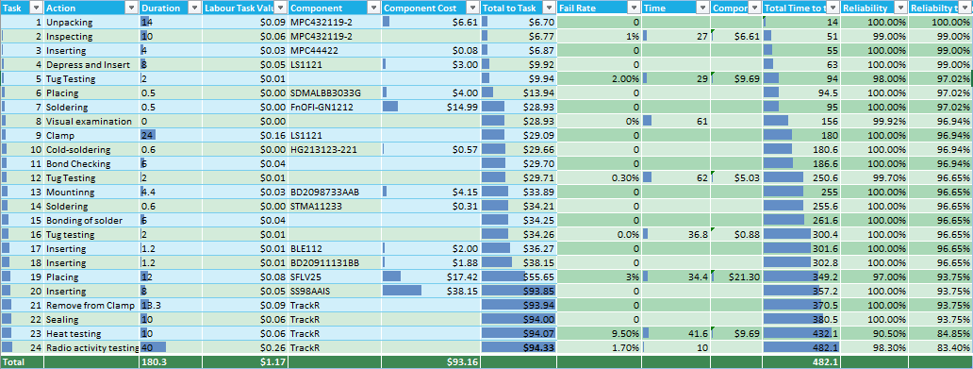
Production To-Be

Slide 50
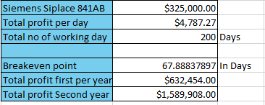
Breakeven Point Table

Slide 51
Training
CDL should ask employees to learn six sigma techniques.
Employees can take free online classes about Six Sigma.
CDL can hire a professional person who can train the workers.
Employee training and organization training.

Slide 52
Divjot Kaur
Automation Implementation

Slide 53
SUGGESTION OVERVIEW
Solution includes purchase of Siemens Siplace Automation Machine.
It will cost $260.000.
It will bring down positioning and soldering for HG213123-221 (3-axis optical gyroscope) and STMA11233 (micro transmitter) to 1.4 sec.
It will last up to 2 years.

Slide 54
PROPOSED SOLUTION
Suggestion is to buy Siemens Siplace 841AB.
Its initial cost will be $260,000.
Its average running expense will be $50.

Slide 55
PROS AND CONS
PROS
One-time investment.
Reduction in positioning and soldering cycle for both HG213123-221 and STMA11233 to 1.4 seconds.
Boost in profit earning by more than $4000.00 per day.
Decrease in time taken for production of one watch.
CONS
Staff needs to be given proper training.
Machine is outdated and may cause some problems.
Lifespan of the unit is not greater than 2 years.
Fail rate might increase.

Slide 56
ASSUMPTIONS
Failure in final test of a product leads to rebuilding all the components.
Time that is taken by replacing components is a part of the failure rate.
There is no additional impact put on time for product building.
Siplace machine would last exactly two years.
Machine has been taken on rent from some private vendor for 15% interest yearly.
Daily expense on machine is $50, which includes electricity, wear and tear.

Slide 57
THANK YOU!
Group 1
INFO8440

Slide 58
References
Fitbit. (2020, March 15). Retrieved from Wikipedia: https://en.wikipedia.org/wiki/Fitbit
Hostspring. (2020, March 19). Retrieved from hostspring.ca: https://hostingcanada.org/
Image. (2020, march 18). Retrieved from https://www.hurriyetdailynews.com/turkish-scientisthonored-with-loreal-unesco-for-women-in-science-award-129258
image1. (2020, march 18). Retrieved from https://www.google.com/search?q=executive&tbm=isch&ved=2ahUKEwjil8jLk6roAhUPOK0KHY OzBJcQ2cCegQIABAA&oq=executive&gs_l=img.3..0i67j0l9.62148.64366..64852...0.0..0.89.667.9......0....1. .gws-wiz-img.M5GFFkbdbEM&ei=l0p1XqLwLY_wtAWD55K4CQ&bih=635&biw=1366#img Kucheriavy, A. (n.d.). How to Measure Your Website’s Performance: Best Metrics & KPIs. Retrieved from https://www.intechnic.com/blog/how-to-measure-your-website-performance-best-metricskpis/
quora. (2020, march 20). Retrieved from https://www.quora.com/What-is-the-conclusion-paragraph-ofan-eCommerce-website sample templates. (2020, February 27). Retrieved from https://www.sampletemplates.com/businesstemplates/statement/confidentiality-statement.html
Sprint3. (2020, March 6). Retrieved from econestoga: https://conestoga.desire2learn.com/d2l/le/content/323280/viewContent/6948007/View
Web Design Overview. (2020, February 28). Retrieved from eConestoga: https://conestoga.desire2learn.com/d2l/le/content/323280/viewContent/6467538/View
Wix.com. (2020, march 15). Retrieved from https://www.wix.com/dashboard/fc2b2fb5-4498-410395b6-8f23ca88faf3/home
https://www.google.com/search?q=tracker+wristband&tbm=isch&ved=2ahUKEwjak4_JlvzoAhUTzawKHZGFC_kQ2-cCegQIABAA&oq=Tracker+wri&gs_lcp=CgNpbWcQARgAMgIIADIGCAAQBRAeMgYIABAFEB4yBggAEAUQHjIGCAAQBRAeMgYIABAIEB4yBggAEAgQHjIGCAAQCBAeMgYIABAIEB4yBggAEAgQHjoECAAQQ1CuA1i-DWDUF2gBcAB4AIAB9QGIAeYEkgEFMy4xLjGYAQCgAQGqAQtnd3Mtd2l6LWltZw&sclient=img&ei=kkugXtqCHZOaswWRi67IDw&bih=876&biw=1821&rlz=1C1CHBF_enIN756IN756#imgrc=axn2W3RXFE38WM
Conestoga College. (2019). Introduction To Lean. Kitchener: Conestoga College, p.25.
Conestoga College. (2020). INFO8440 Project 3 Production Overview. Retrieved from eConestoga: https://conestoga.desire2learn.com/d2l/le/content/323280/viewContent/6467535/View
Conestoga College. (2020). Staff Attitude Survey Results 150327. Retrieved from eConestoga: https://conestoga.desire2learn.com/d2l/le/content/323280/viewContent/7025321/View
Conestoga College. (2020). Staffing 1of2. Retrieved from eConestoga: https://conestoga.desire2learn.com/d2l/le/content/323280/viewContent/6467563/View

